Slide 1

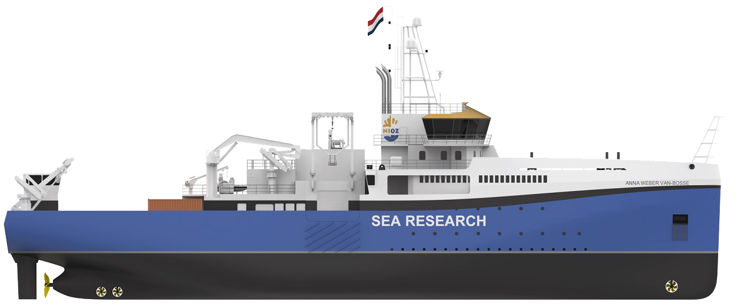
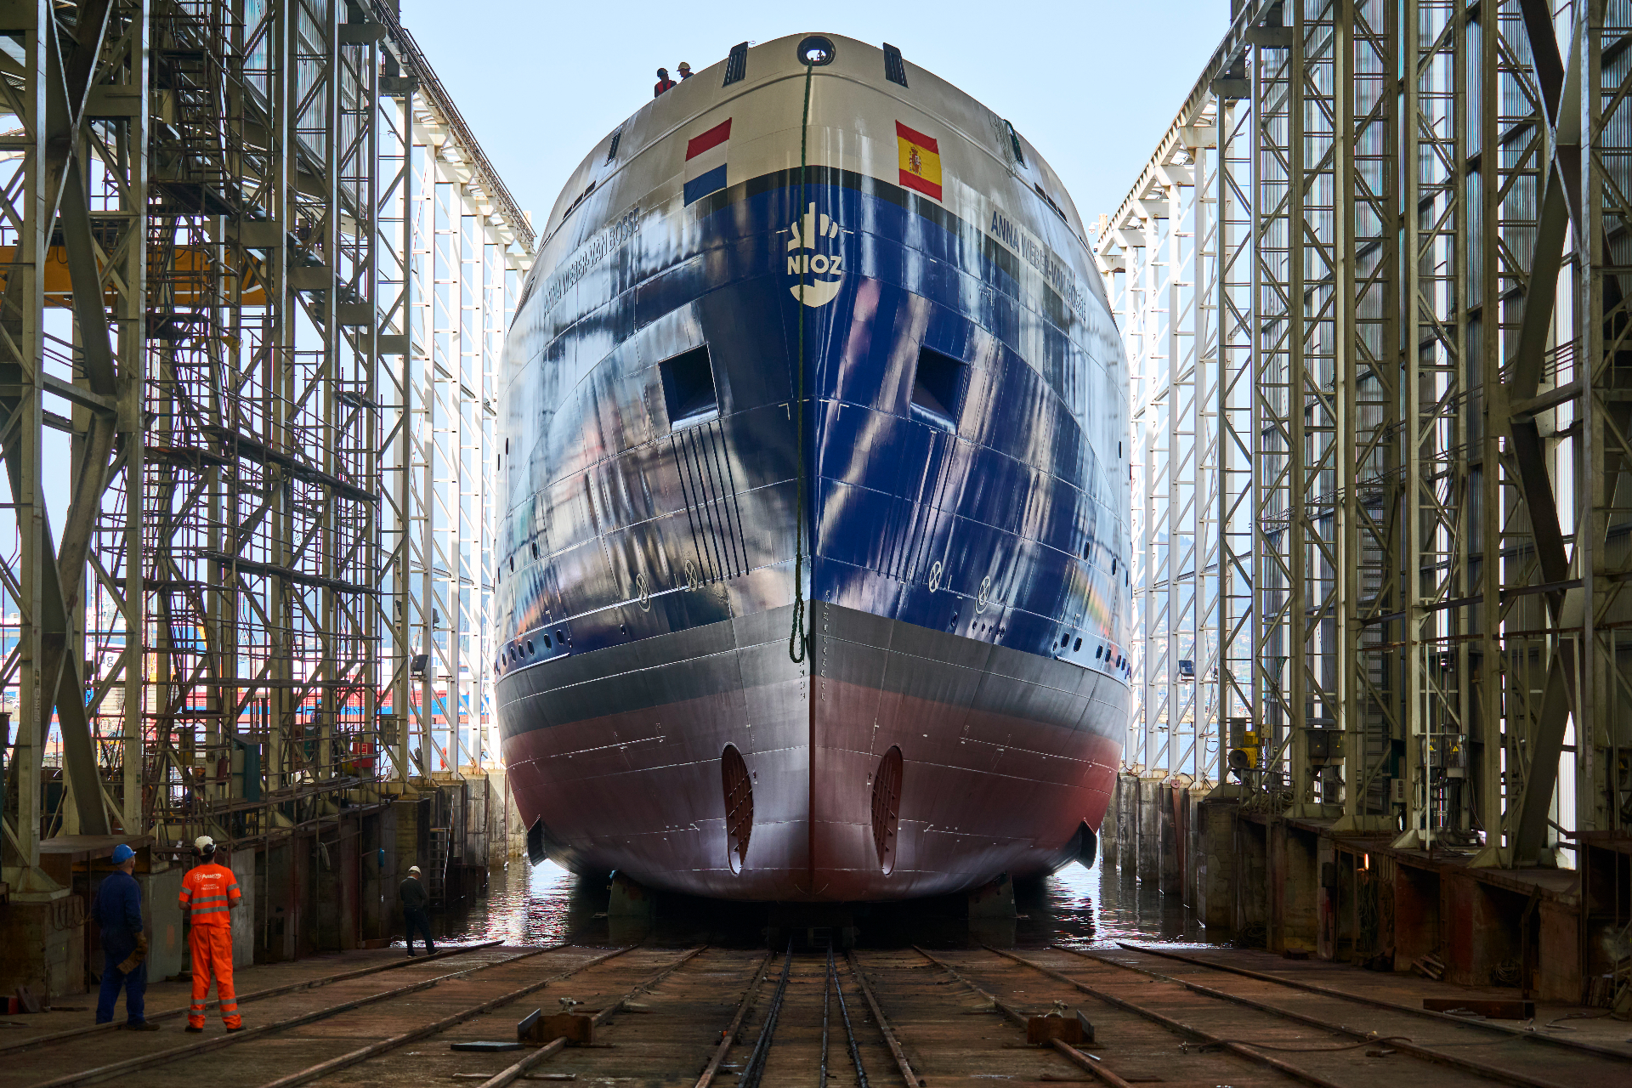
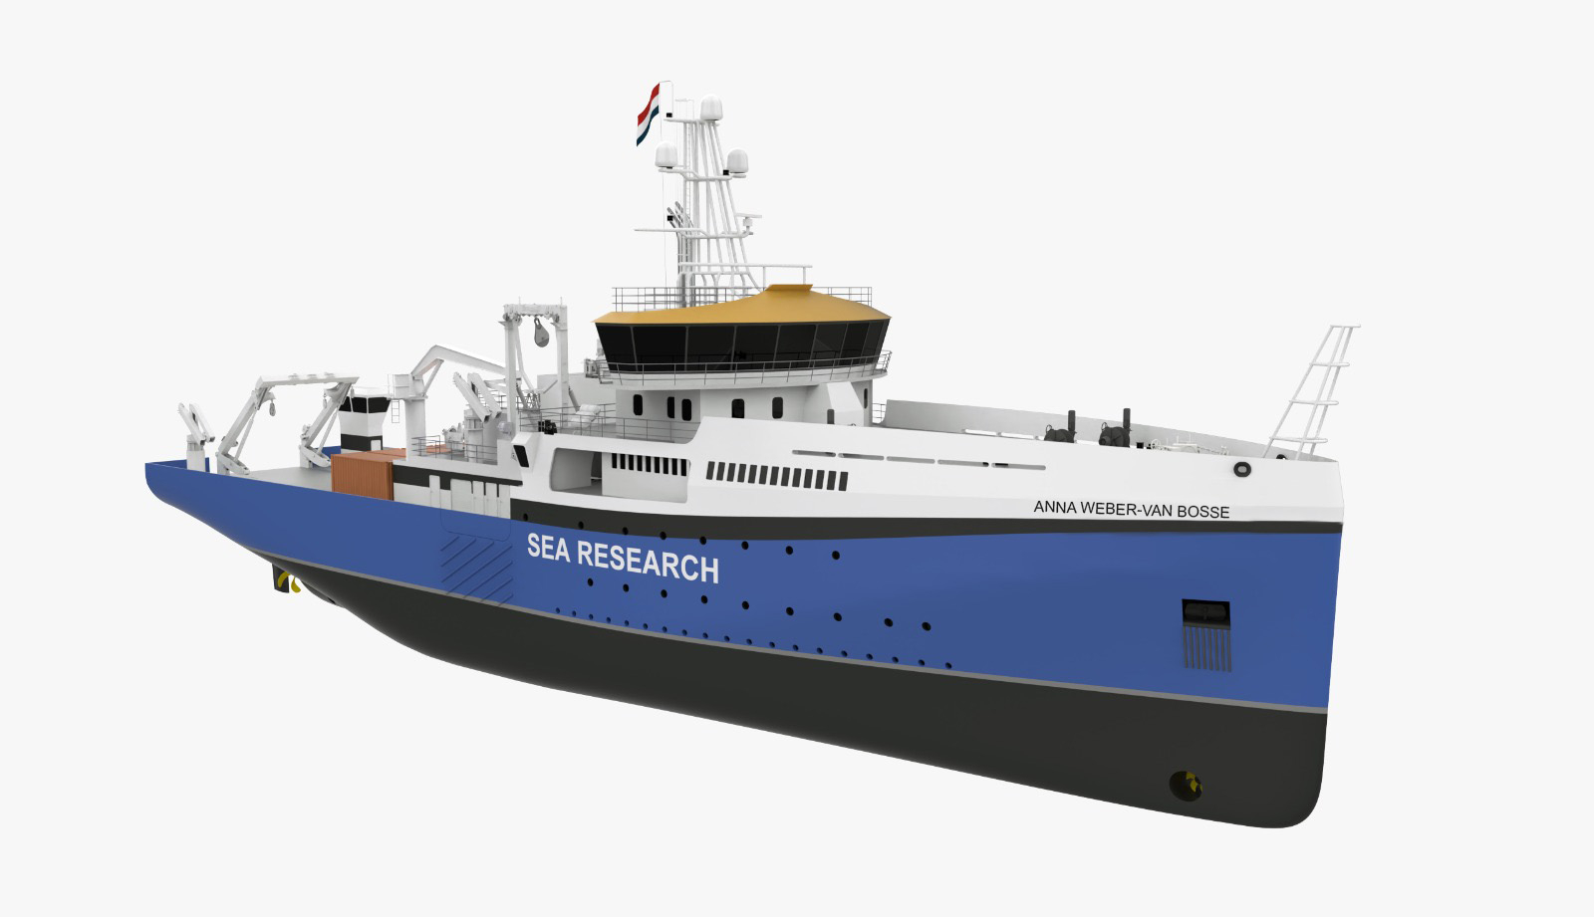
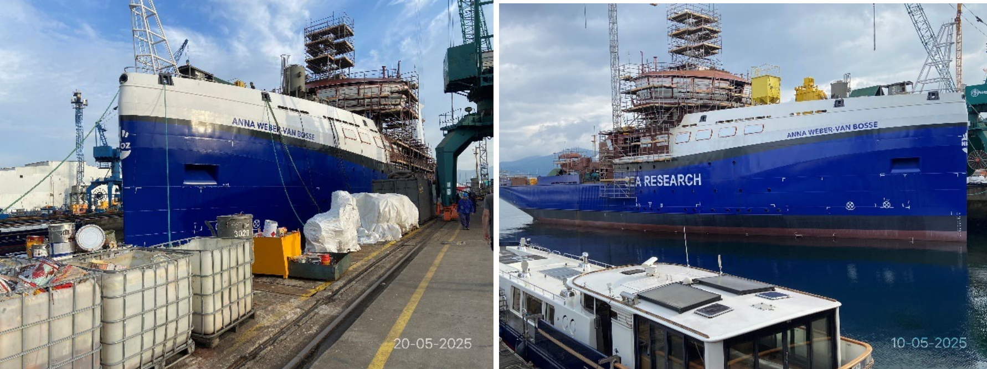



RV Anna Weber -van Bosse
The new Dutch ocean-going research vessel
Sustainability measures
coordinatorNMF@nioz.nl
General Specifications
Length | 79.9 m
Beam | 17 m
Draught | 5 m; 5.5 m
Class | Special purpose RV - Ice Class IC
Service speed | 10 knts
Endurance | 40 days
Accommodation | 16 crew + 30 Passengers
Energy Consumption
To reduce the impact of our ship operations on the environment, most attention is paid to optimizing the entire energy generation, storage, and consumption. Since most of the energy consumed still finds its origin in fossil fuel, consumption should be optimized and with that minimized.
Specific items applied for this:
installed battery pack to deliver to or extract from the system, to have less simultaneous running hours of both generator sets, and to have the running hours on average closer to the optimum performance of the generator sets with a smaller standard deviation
heat recovery from:
  Cooling waters
  HVAC system
Solar panels to generate renewable energy
High isolation windows to reduce AC use
Delivery
Autumn 2025
Full Operation
Autumn 2026
Science trials
Spring Summer 2026
Emission
Methanol-prepared to be ready for a sustainable fuel, in which case, the emission of polluting gases and substances
DPF in the exhaust system to filter the soot
Challenges for methanol
Loss of cargo space, High flammability.
Bunkering infrastructure is still in the early stages
Fuel costs, still some uncertainty
Resources
Next to optimizing energy consumption, attention is also paid to the use of resources, for example, through:
recycled plastic deck covering to save resources
Photos from the May Newsletter from the build site
Armon Shipyards, Vigo, Spain, May 2025
Follow the project:
News RV Anna Weber-van Bosse - NIOZ

